Slide 1
Staying Safe While You Consider breast Reconstruction Surgery
Barry k. Douglas, MD, facs Long Island Plastic Surgical Group, PC

Slide 2
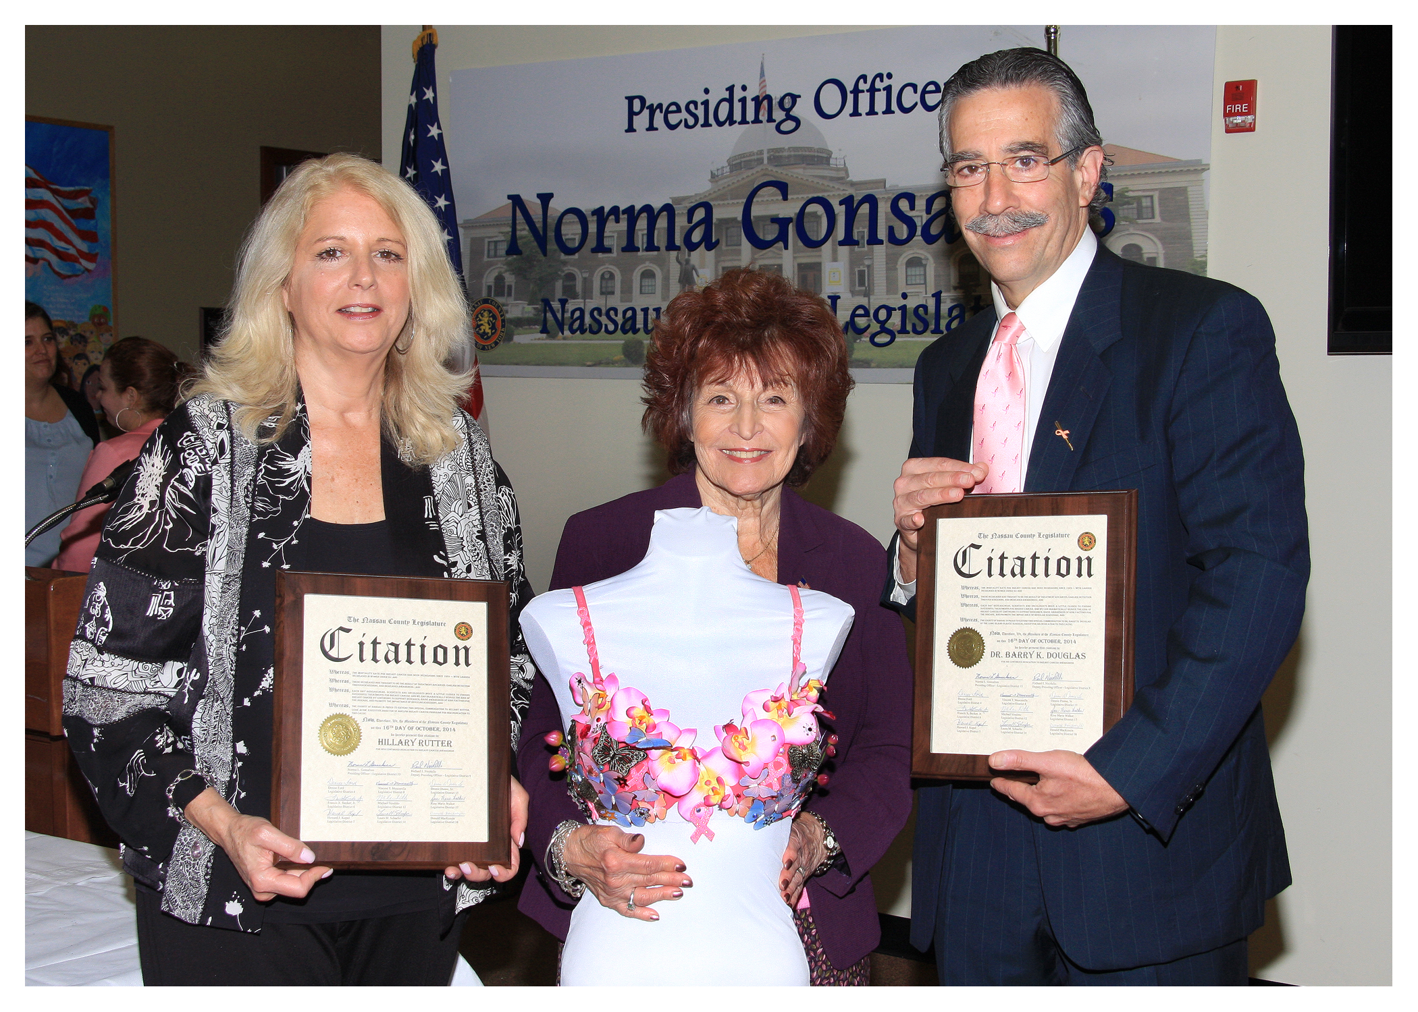

Slide 3
Safety precautions in the office

Slide 4
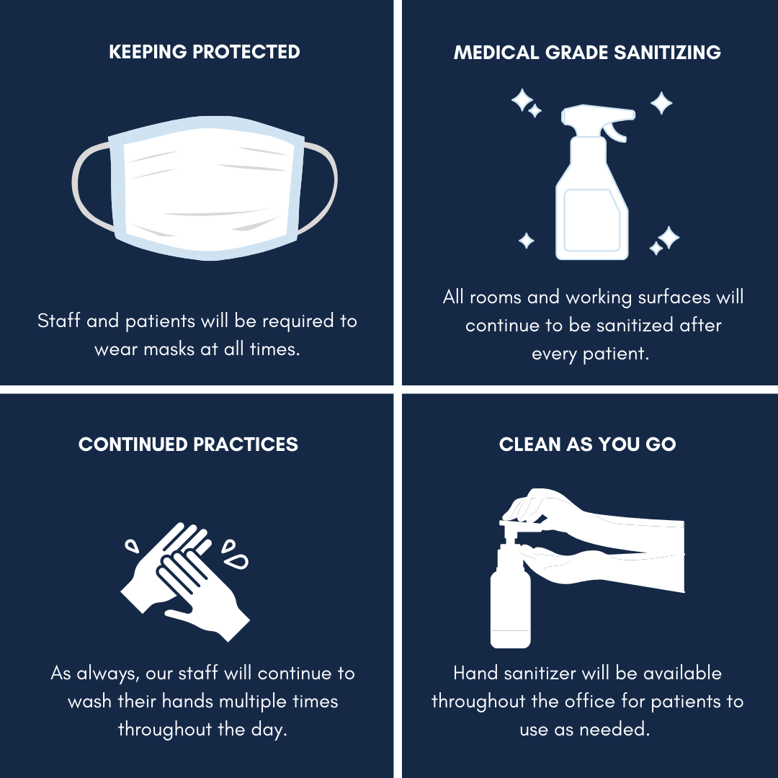
Safety precautions in the office

Slide 5
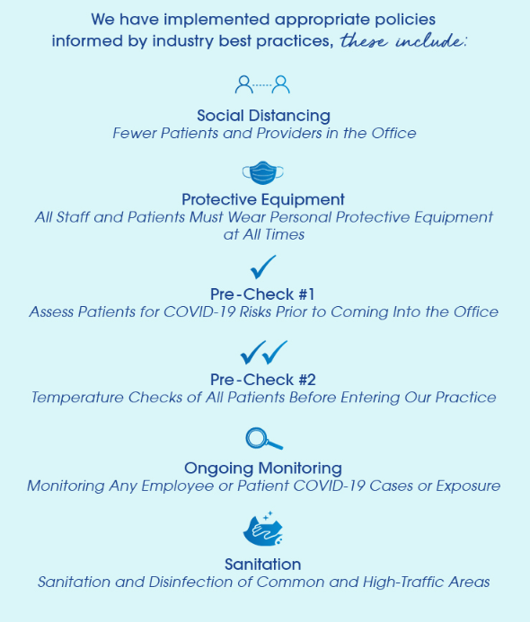
More Safety precautions in the office

Slide 6
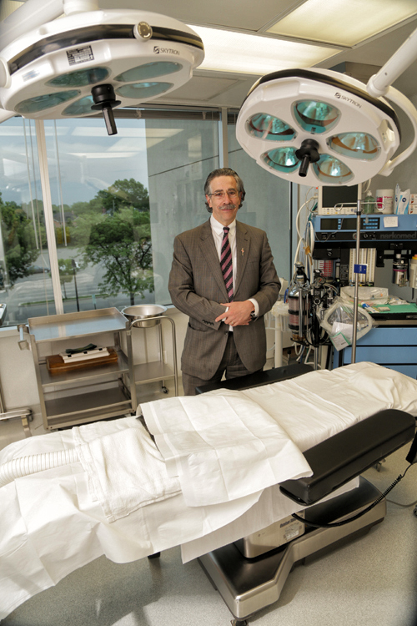
Safety precautions in the operating room
I am the Surgical Director of the ORs at the Long Island Plastic Surgical Group in both Garden City and Park Avenue.
The OR is one of the safest possible places when considering an environment essentially germ free.
When comparing Pre-COVID and present COVID environments, there’s not much of a difference in terms of the rigorous and methodical way the OR is cleaned.
Healthcare providers in the OR are now completely covered in PPE, which is similar to pre-COVID-19, with the addition of a gown on top of scrubs.

Slide 7
telehealth

Slide 8
breast cancer surgeries during the pandemic
OR space was essentially unavailable for any elective surgery leading up to and during the height of the pandemic.
Almost all surgeries were on an emergent basis. Therefore most breast surgeries and reconstructions were put on hold.
Those that couldn’t wait could be reconstructed with implant based modalities.
There were essentially no autologous tissue reconstructions.
These are longer and more involved surgeries.
Patients on neo-adjuvant chemoRx were considered cases that could be delayed.
When the curve began to trend downward, elective cases resumed. ASUs opened the last week of May.

Slide 9
Breast reconstruction options during covid-19 during limited or time
For lumpectomy/breast conservation
Oncoplastic tissue rearrangement
For mastectomy reconstruction
Implant based. Either staged tissue expander with ADM or direct to implant with ADM
Symmetrizing procedures of the contralateral side would require a second surgery

Slide 10
Questions

