Slide 1
Occupational Therapy
What is it and how can a specialized occupational therapist assist with breast cancer rehabilitation?

Slide 2
OT – It’s not the “Other Therapy”
OT differs from physical therapy in that the focus is on performing activities of daily living as independently as possible, sometimes with modifications.
OT also “overlaps” with PT by addressing range of motion and mobility impairments.

Slide 3
OT and Breast Cancer
Education
Lymphedema risk-reducing strategies/precautions
Signs/Symptoms of lymphedema, identify and refer
ROM and lifting restrictions
Take post-op arm measurements, compare with pre-op measurements when available
The lymphatic system is different in each person. We have varying numbers of lymph nodes.
Lymphedema risk is not one size fits all. The goal is not to overload the compromised lymphatic system.
Your activity level has a lot to do with how much your lymphatic system can tolerate.

Slide 4
Lymphedema Risk reducing strategies
What can you do to help prevent lymphedema?

Slide 5
Avoid direct heat to affected arm
Do not use a heating pad on affected shoulder or arm
Avoid hot tubs and saunas
Avoid hot yoga
Check hot water temperature with unaffected hand

Slide 6
Avoid compression to the affected arm
Carry bags and purses on opposite arm
Avoid blood pressure, especially automatic machines
Avoid tight clothing and jewelry
Avoid deep massage to that shoulder and arm
*A properly measured and fitted compression sleeve and glove should be worn in certain circumstances

Slide 7
Try to prevent infections
Use sunscreen
Moisturize daily with lotion without chemicals in it
Wash cuts, apply Neosporin and band-aid
Check skin daily
Wear gloves when cooking or cleaning to avoid burns/injury
Shave under affected arm with electric razor
No needles to that arm (IV, injections, blood draws)
Offer non-affected hand to unfamiliar pets
No tattoos to shoulder/arm
Push back cuticles versus cutting during manicure, bring your own tools if possible

Slide 8
CAUTION
A therapist who isn’t knowledgeable in breast cancer recovery can do more harm than good!

Slide 9
michele@Pinklotustherapy.com
516-544-8898
Thank You!

Slide 10
ADELPHI
BREAST CANCER HOTILINE & SUPPORT PROGRAM
Empower
Educate
Managing your Lymphedema
2017
Restore
Presented by: Diana Tjaden PT, DPT

Slide 11
Team Approach
Oncologists, and Breast Surgeons…….
PROVIDE A CURE
Plastic Surgeons……
RESTORE THE CONTOURS
Physical Therapists, Occupational Therapists, & Lymphedema Therapists……
RESTORE FUNCTION & QUALITY of LIFE

Slide 12
The Lymphatic System…. The philosophy behind the practice
Restoring range of motion :
The amount of motion
Tissue mobility
Progressing with a guided strengthening program:
To safely build up the endurance of the lymphatic system
Notes:
The lymphatic system consists of nodes & vessels
Nodes are connected by vessels
Larger vessels in center of the body..then branching out
There are 600-700 in the body
They work hand in hand with the circulatory system that consists of arteries & veins.

Slide 13
Range of Motion, Soft Tissue Restrictions, & Flexibility Deficits
Commonly due to:
Muscles affected during surgery
Poor posture
Scar tissue from surgical procedures
Sequelae of radiation therapy
Pain
Fear of movement

Slide 14
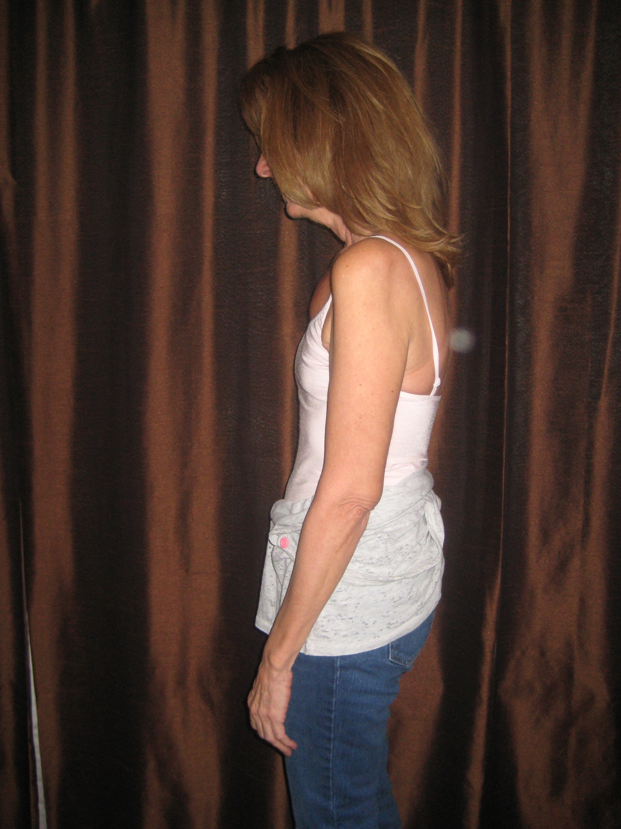
Poor Posture
Common Contributors:
Pain
Postural Asymmetries
Muscle Imbalances
Posture prior to diagnosis

Slide 15
Axillary Web Syndrome/Cording
Characteristics:
Palpable “cords” in the axilla, upper arm, front of forearm & possibly chest
Very specific “line of pain” down the inside of the arm & back of thumb
Usually appears 3-5 weeks post op. but can reappear months or years after surgery
Complaints include inability to straighten elbow & bring arm out to side due to pain from the arm to the wrist

Slide 16
Radiation
The literature states that tightness from radiation therapy takes place for a minimum of 2 years after completion of treatment
Feeling of tightness or loss of motion typically occur 4-6 weeks after treatment ends
What can be done?
Stretching on a daily basis

Slide 17
Tissue Response to Radiation
Post Implant Reconstruction
12 Weeks
Post Implant Reconstruction
Non Radiated
Notes:
Next is the tissues response to radiation..
Note the color of the tissue
How you can see the superior border of the implant on this side
It sits more superior
The right side looks softer

Slide 18
Strength Deficits & Muscle Imbalances
Commonly due to:
Muscles & nerves affected during surgical procedures
Treatment: chemotherapy, radiation, corticosteroid medications
Disuse

Slide 19
Strengthening Guidelines
(American College of Sports Medicine, 2010)
Avoid inactivity
2-3x/wk including exercises for large muscle groups
Progress at slow increments with no upper limits on any amount of weight survivors can progress to
If a break is taken from exercise, progress back very slowly. Start with no weight or very light weights
ACSM has proposed at least 16 visits of supervised exercise before an independent program
Notes:
In regards to exercise progression it is very individual and progression is determined by many factors.
However, it is vey important to progress slowly. Perform 2-3 sets of 10 repetitions without any weight for 1 wk, before progressing.
When it is time to progress it is important to do so in 1 lb increments, following the same guidelines

Slide 20
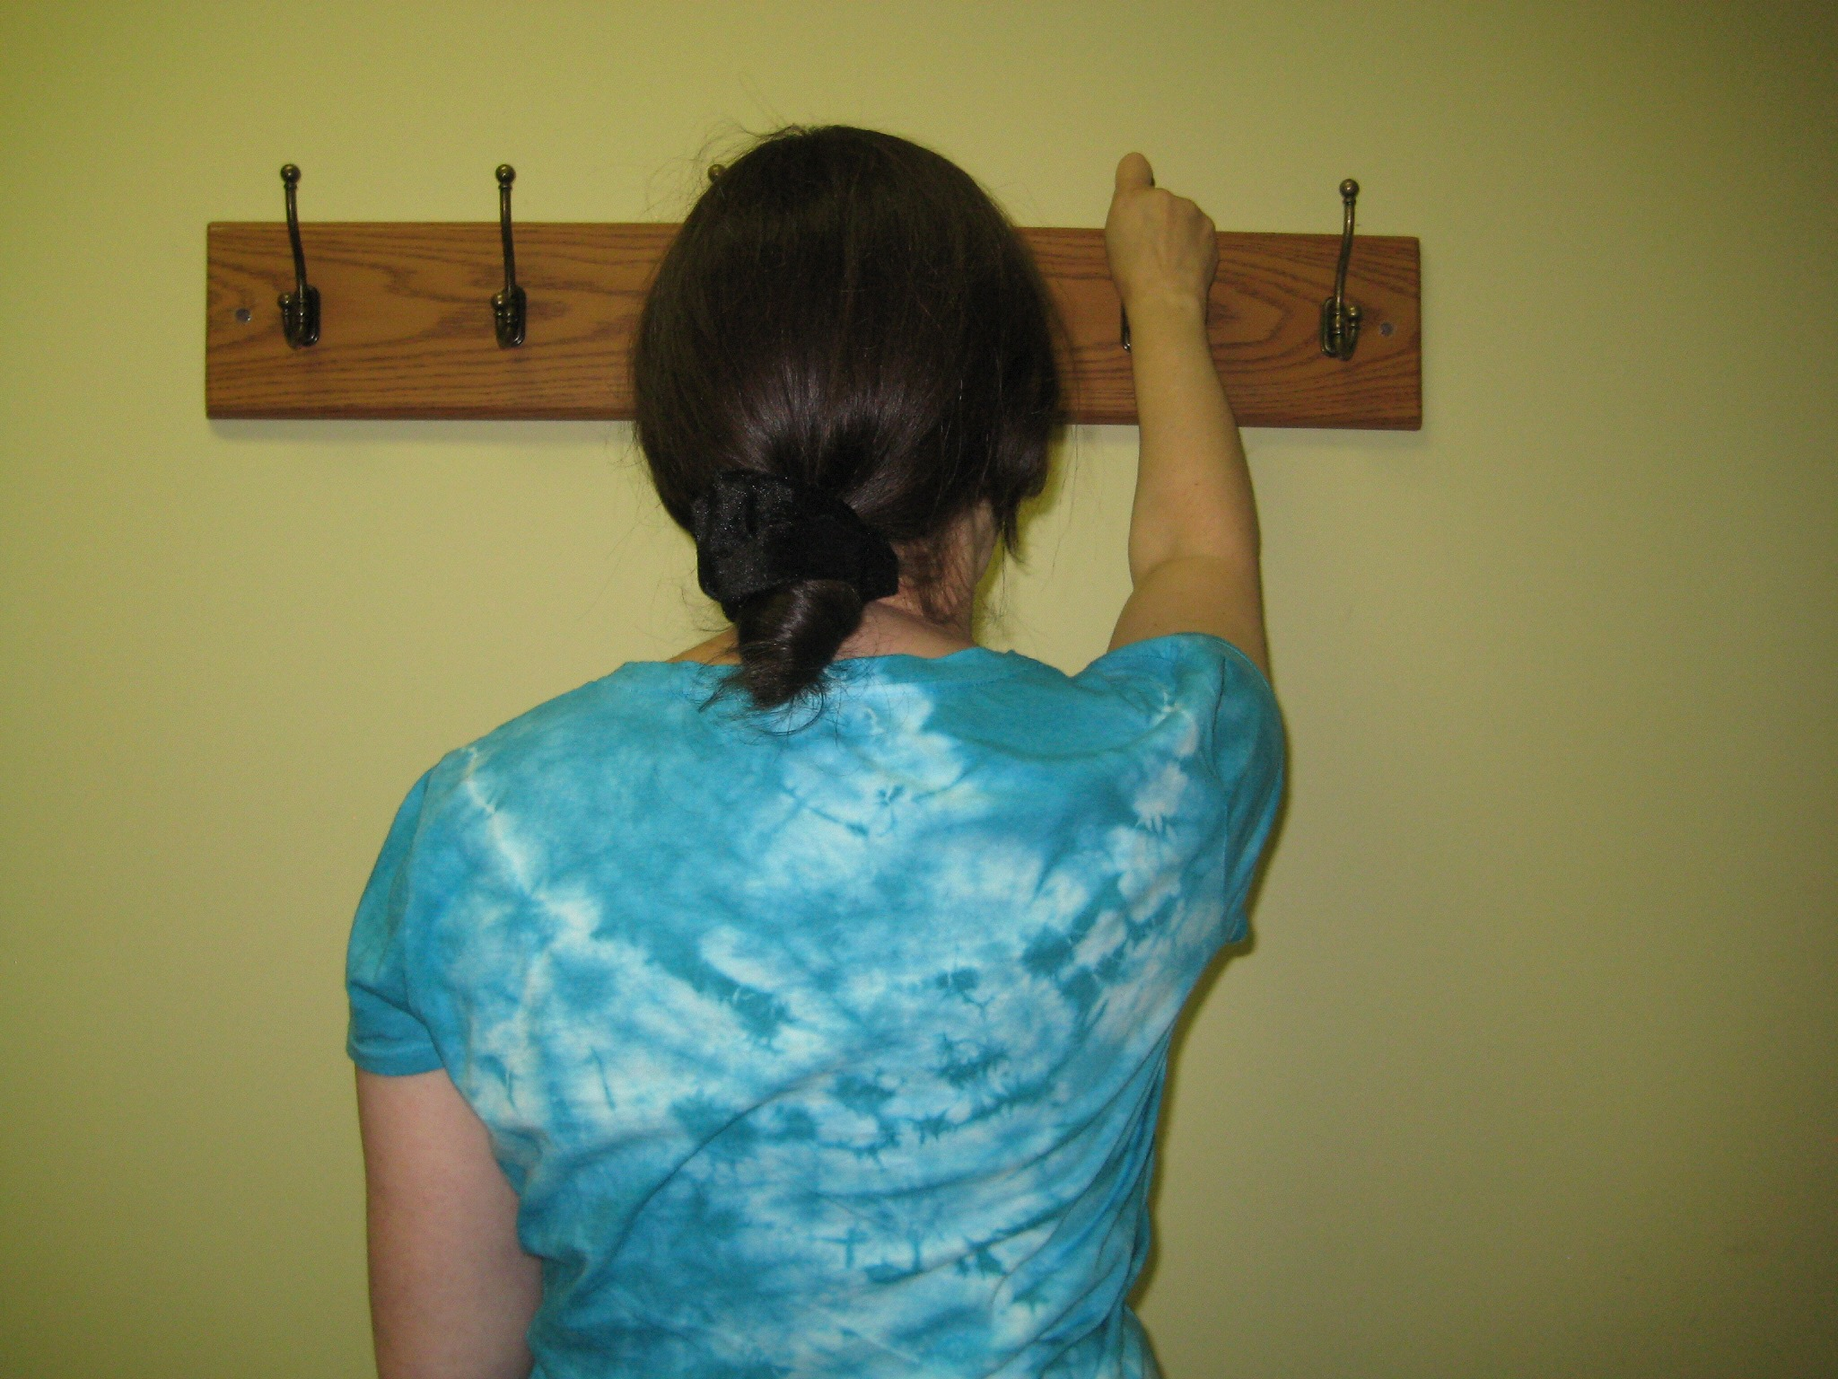
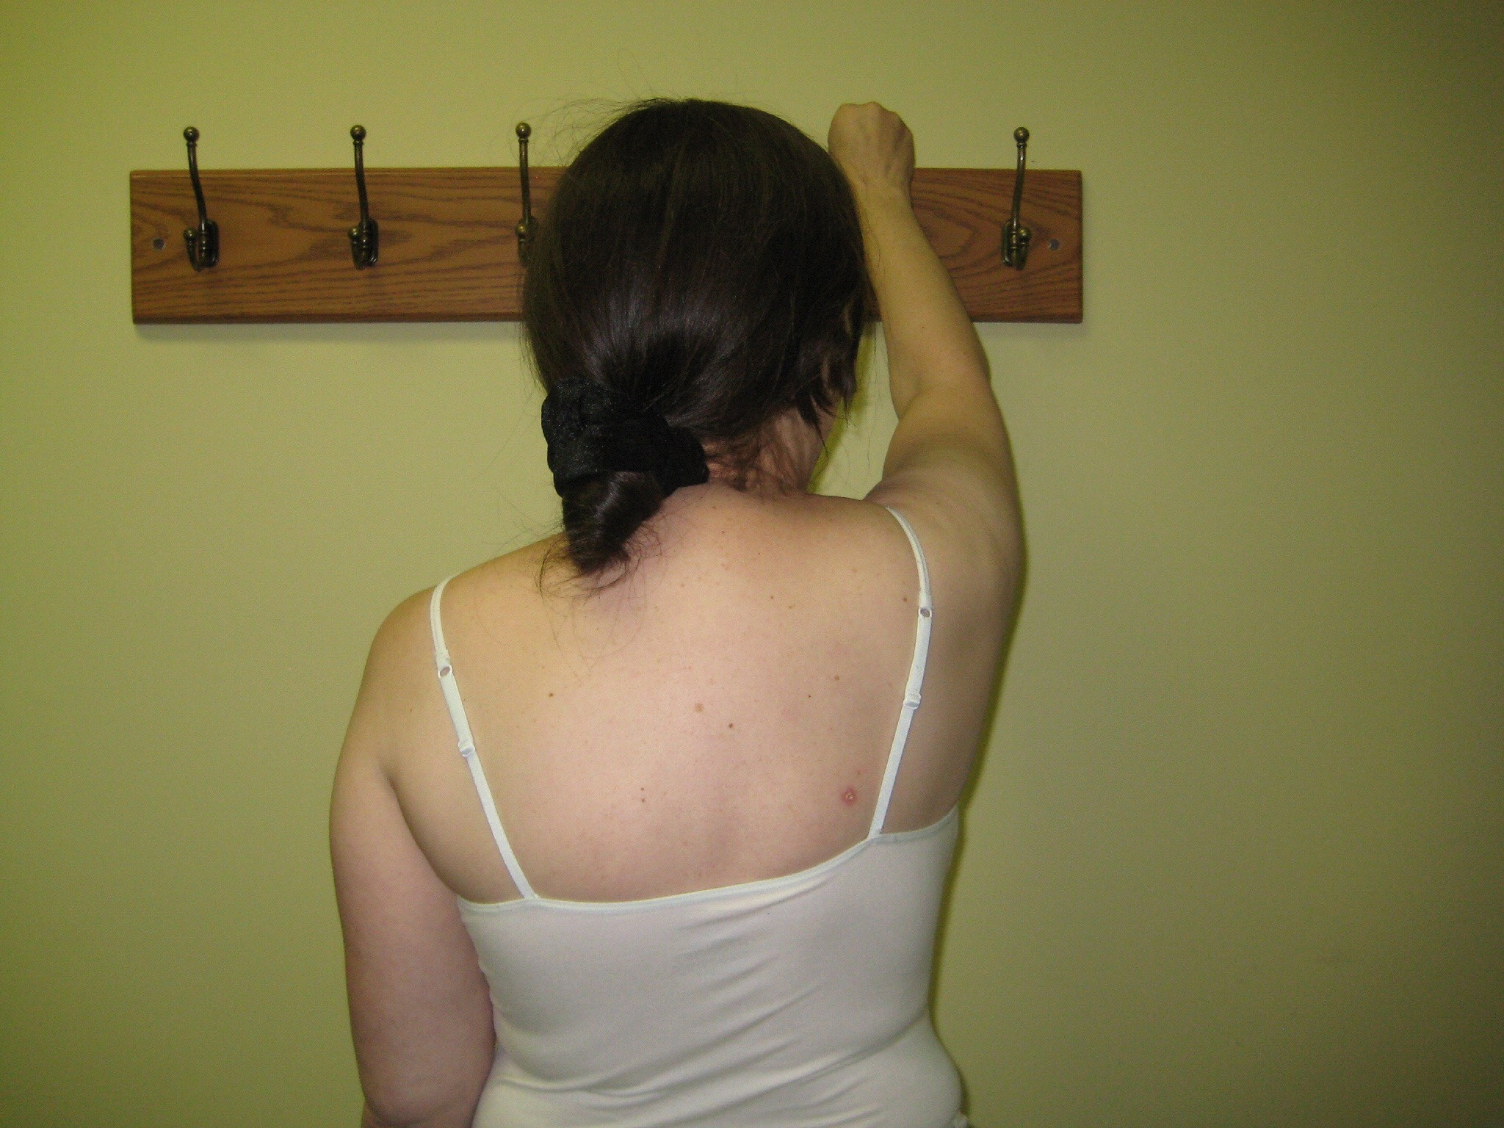
Strength, Flexibility, Range of Motion & Soft Tissue Deficits Commonly Lead To......
Silent Impairments
Notes:
These are the impairments that some of the patients are not even aware of…..
When I asked this PT to raise her arm with her shirt on this is what i saw..her motion looked relatively normal
However..when I asked her to reach just a little bit higher...which is common during tasks such as reaching, putting on a bra, or coat, these impairments became obvious
If she were to continually perform this motion, over time breakdown would occur and pain would develop!
This is the patient like liz who would slip through the cracks
The patient who would be seeking physical therapy after they returned to their prior level of function and have now developed tendonitis or a frozen shoulder
Compensations are more difficult to address as time goes by, so if they are addressed earlier there would be many less problems
Altered shoulder biomechanics
Soft tissue and/or muscle tightness/weakness
Scapular weakness/dyskenisia

Slide 21
Cardiovascular Exercise & Lymphedema
Thought to be beneficial for individuals with lymphedema
Deep respiration enhances lymph drainage
Avoid injury by increasing very gradually
Avoid getting overheated (heat illness)
Modify your program according to your symptom response
Cardiovascular Exercise & Weight loss…
⬇ Weight Gain = ⬇ Recurrence
Losing as little as 5 Lbs can make a BIG difference!!
Interval training is most effective

Slide 22
Patient Education
Educate patients on flexibility, strengthening, & cardiovascular exercises within appropriate post surgical/treatment time frames
Skin care guidelines & precautions to follow in order decrease the risk of lymphedema
Refer to appropriate support groups or community programs
Allows patients to be active participants in their recovery & take control over their lives!
Notes:
The Women's Health and Cancer Rights Act 1998- mandatory coverage of recon, coverage of surgery on opposite side if needed to ensure symmetry, payments for prosthesis, bras & any complications from mastectomy including Lymphedema
Medicare: 2 bras every yr 1 prosthesis every 5…no bandages or garments

Slide 23
FullCircleBreastCancerPT.com
Diana@ FullCircleBreastCancerPT.com

Slide 24
Lymphedema
Presented by…
Diane Raspanti LANA/CLT
practicing since 1985 with main concentration in Complete Decongestive Therapy.
Certified as a Lymphedema Therapist by Lerner Lymphedema Services in 1994.
LANA certified 1996
The Association of Bodywork & Massage Professionals

Slide 25
Lymphedema
An abnormal accumulation of protein-rich fluid in the interstitium, which causes chronic inflammation and reactive fibrosis of the affected tissues.
Causing swelling of a body part, most commonly an extremity.

Slide 26
Overview of Lymphatic System

Slide 27
Lymph Flow Increased By:
Exercise
Peristalsis
Negative intrathoracic pressure (inspiration)
Cardiac activity
Rise in venous pressure (not arterial)
Massage
PROM

Slide 28
Areas that may be affected post surgically
Affected breast
Trunk
Chest wall
Entire radiation field
Arm
cording

Slide 29
Incidence
Occurs to some degree in 30% to 40% of women who have had axillary node dissection, but severe in only 10%.

Slide 30
Characteristics of lymphedema
Progressive, slow in onset
Pitting is present in early stages (30% increase in lymph fluid already present before signs seen)
Heaviness, achiness, pulling sensation (taut) of UE, & discomfort.
Rarely painful
Starts distally in both UE & LE

Slide 31
Subacute stage
Transport capacity of lymphatic fluid is reduced secondary to surgery, trauma, infection…
No visible pitting or edema
Subjective complaints may be discomfot, heaviness or achiness of the affected limb.

Slide 32
Stage I Reversible Lymphedema
Accumulation of protein rich lymphatic fluid
Pitting Edema
Reduces/Subsides with elevation
No Fibrosis present

Slide 33
Stage II Spontaneously Irreversible Lymphedema
Progression of the accumulation of protein rich lymphatic fluid.
Pitting becomes more difficult
Fibrosis, connective tissue proliferation (scar)
Not self correcting

Slide 34
Stage III Lymphostatic Elephantiasis
Progressive accumulation of protein rich lymphatic fluid.
Non pitting due fibrosis
Extensive fibrosis and sclerosis (severe induration)
Skin changes ( papilomas, weeping, hyperkeratosis

Slide 35
Manual Lymphatic Drainage
MLD improves lymph circulation through gentle manual techniques
MLD breaks down fibrosis
MLD increases lymph flow to collateral unaffected vessels

Slide 36
Compression Bandaging
Improves the efficiency of the muscle joint pump
Prevents the reaccumulation of evacuated lymph fluid
Helps break down fibrosis
Bandages stay on until next MLD session.

Slide 37
Remedial Exercise Program
Therapeutic Exercises are performed with the bandages in place
Benefits are increased lymph circulation
Breathing exercises increases the volume of lymphatic fluid through the Thoracic Duct

Slide 38
Skin & Nail Care
Reduces chance of infection
Eliminates bacterial and fungal growth

Slide 39
Home Maintenance Program
Instruction in Self massage
Bandaging
Exercise Program

Slide 40
Goals of Treatment
Redirect and use the remaining unaffected lymphatic vessels and pathways.
Remove the excess lymph fluid from the affected limb
Eliminate fibrotic or scar tissue
Avoid the re-accumulation of lymphatic fluid
Prevent Infection
Achieve & Maintain as near as normal limb size.

Slide 41
Physical rehabilitation should be SYNONYMOUS with cancer care.
Promotion of wellness allows an individual the opportunity to meet future health challenges.

Slide 42
Therapy Mission
Through education, rehabilitation, exercise and emotional support we strive to empower our patients diagnosed with cancer to maintain and improve their quality of life during and following cancer treatment.

Slide 43
Lymphedema Medical and Surgical Management
Thomas A. Davenport, M.D.
Long Island Plastic Surgical Group
Chief Division of Plastic Surgery
Director of Microsurgery
Director Surgical Wound Care
Winthrop University Hospital

Slide 44
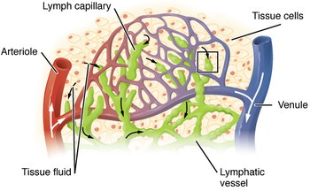
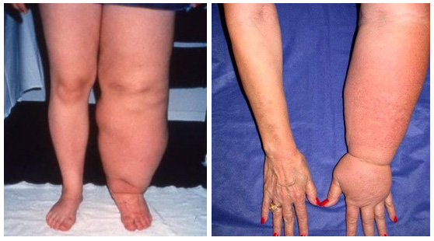
Lymphedema Classification
Primary
Secondary

Slide 45
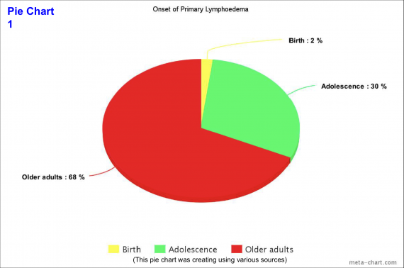
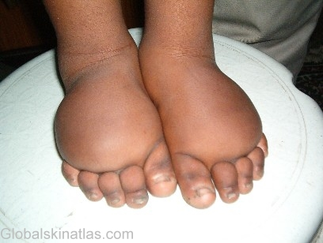
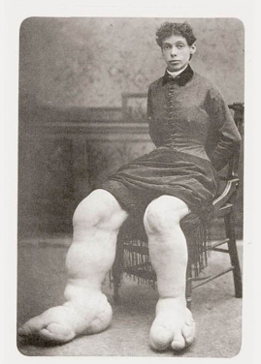
Primary Lymphedema
Milroy Disease (Infancy)
Lymphedema Praecox (adolescence)
Lymphedema Tarda (30’s)

Slide 46
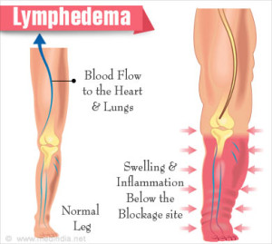
Secondary Lymphedema Normal Lymphatics
Disruption
Obstruction
Schlerosis

Slide 47
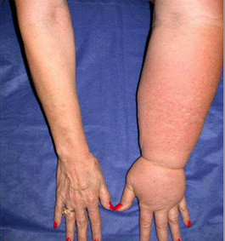
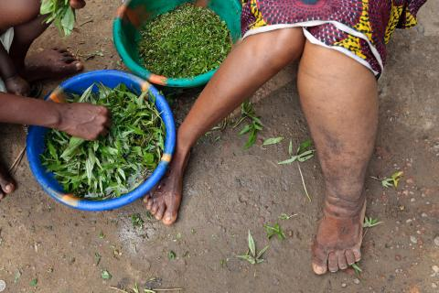
How big is this problem ?
Cancer Treatment
Trauma
Limb Dependency Edema
Cardiac Disease
Filiariasis
Phlebolymphedema
Lymphatic Malformations

Slide 48
Lymphedema Incidence Cancer
Melanoma 16%
Gynecologic Cancers 20%
Genitourinary Cancers 10%
Head/Neck Cancers 4%
Sarcomas 30%

Slide 49
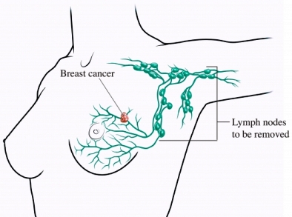
Breast Cancer Lymphedema
Surgery
Radiation
Cancer
Other Factors

Slide 50
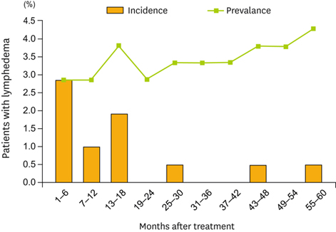

Slide 51
Breast Cancer Lymphedema Incidence
6% to 94% Within 5 Years

Slide 53
Lymphedema Incidence Breast Cancer Risk
Mastectomy Higher
Lumpectomy Lower
Axillary LND Higher
Sentinal Node Lower
Radiation Higher

Slide 54
Lymphedema Staging International Society For Lymphology
Stage 0 Latent or Subclinical
Stage I Mild Edema/Reversible
Stage II Pitting Edema/Non-reversible
Stage III Fibrosis/Skin Changes

Slide 55
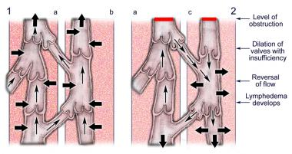
Pathophysiology
Lymphatic Blockage
Loss of Venous Connection
Sclerosis/Fibrosis
Loss of Transport System
Inflammation
Genetic Predisposition

Slide 56
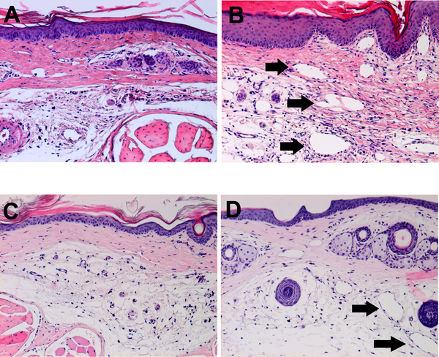
Pathophysiology
Complex Interaction
Blockage/Disruption Not Enough !

Slide 57
Lymphedema Big Problem
Disfiguring
Psychological Distress
Functional Impairment
Economic Impact

Slide 58
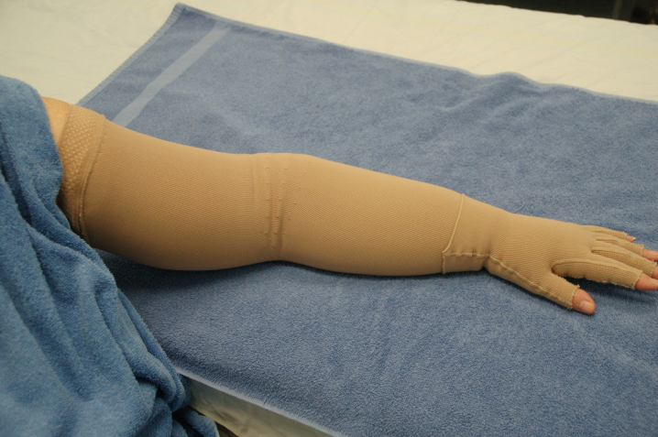
General Management
Exercise and Movement
Compression and Massage
Skin Care
Risk Factor Reduction
Pain/Psychosocial Management

Slide 59
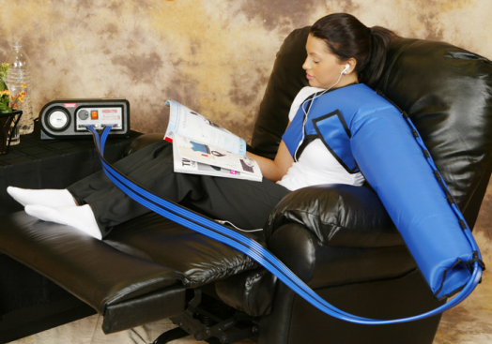
Non-Surgical Management
Manual Lymphatic Drainage
Combined Physical Therapy/Compression
Thermal Therapy
Medication
Laser Therapy
Pneumomassage
Exercise/Elevation
Diet/Weight Loss
Skin Care

Slide 60
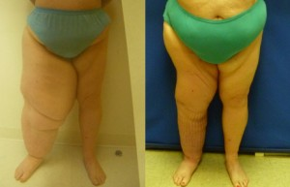
Surgical Management
Liposuction
Ablative Surgery
Lymphovenous Bypass
Lymph Node Transfer
Free Tissue Transfer
Flap Interposition
Node/Venous Shunt

Slide 61
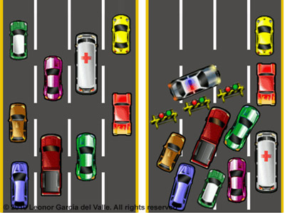

Slide 63
Excisional Approach
Charles Procedure 1912
Sir Richard Henry Havelock Charles
Chief Medical Officer Afghan Boundary Commission
Calcutta, Bengal Medical College
Rarely Used Treatment

Slide 64
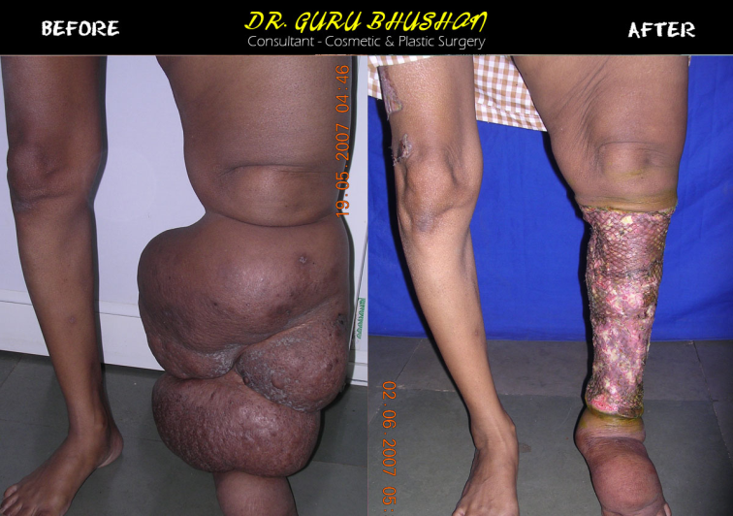
Charles Procedure
Complete Excision of
Skin
Subcutaneous Tissue
Muscle Fascia
Skin Graft to Muscle

Slide 65
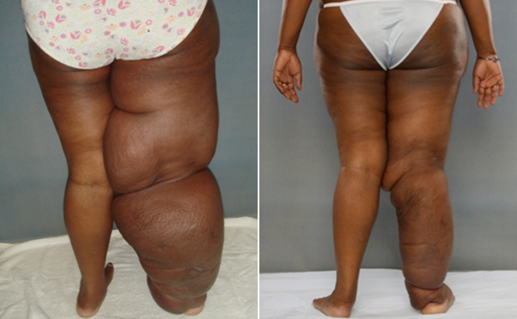
Kondoleon Procedure
Excision of Vertical Strips
Skin/Subcutaneous Tissue
Connection to Deep Fascial System

Slide 66
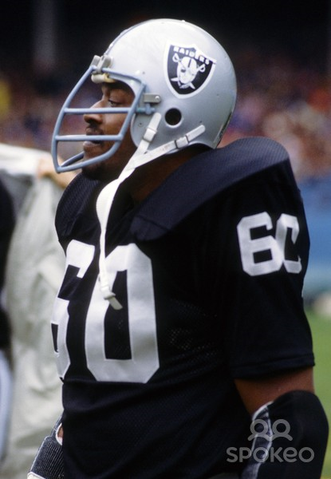
Sistrunk Procedure 1918
Walter Ellis Sistrunk
Mayo Clinic
Excision of large wedges of tissue
Creation of fascial window

Slide 67
Homans-Miller Procedure 1936
Medial/Lateral Incisions
Excision of Subcutaneous Tissue
Multiple operations needed

Slide 68
Thompson Procedure 1962
Tissue excised
De-epithelialized dermal pedicle used to create lymphatic drain

Slide 69
Macey Procedure
Staged Skin Grafting
Keeping Skin/Subcutaneous Tissue Intact

Slide 70
Take Home Message …
… These are very morbid procedures !
… There has got to be a better way !

Slide 71
Excisional Procedures Modifications
Add
VAC therapy
Add foot tissue excision
Better skin graft care
Other newer procedures

Slide 72
Where Are We Now ?
Staged Subcutaneous Excision
Medial/Lateral Staging
Several Months Apart

Slide 73
Meets…

Slide 74
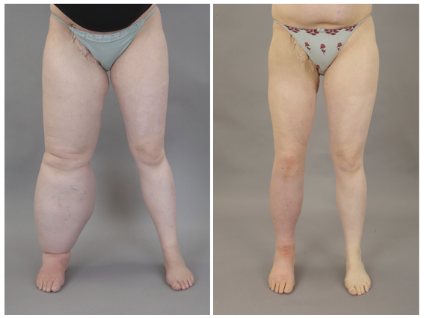
Liposuction
Safe
Does not disrupt the lymphatics
Not as dramatic as excision

Slide 75
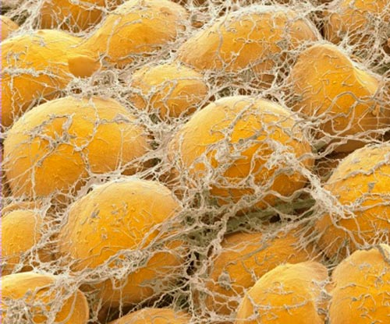
Adding Fat as a Treatment, That’s Crazy !
Cell-Assisted Lipotransfer Using Autologous Adipose-Derived Stromal Cells for Alleviation of Breast Cancer-Related Lymphedema.
Toyserkani NM¹, Jensen CH², Sheikh SP², Sørensen JA³.

Slide 76
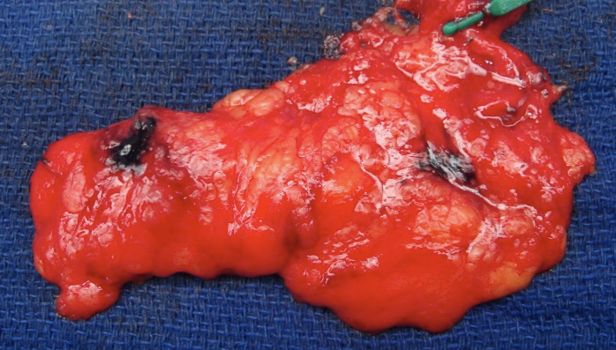
Lymph Node Transfer
Microsurgery
Relies on Lymphatic Growth
Used in Conjunction with other treatments

Slide 77
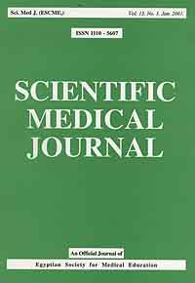
Well … This is Kind of New
Clinical and Psychosocial Outcomes of Vascularized Lymph Node Transfer for the Treatment of Upper Extremity Lymphedema After Breast Cancer Therapy.
Gratzon A¹, Schultz J², Secrest K¹, Lee K¹, Feiner J¹, Klein RD^{3,4}.

Slide 78
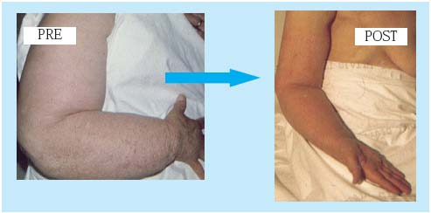
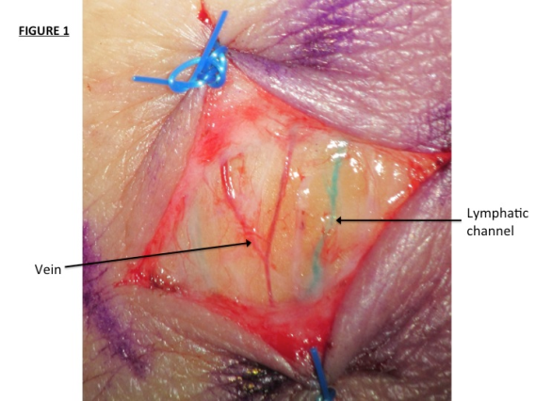
Lymphovenous Bypass Lymphaticovenous Bypass
Microsurgery
Connects Lymphatics to veins
Used in conjunction with other treatments

Slide 79
It Works … Enough
Supermicrosurgical lymphaticovenular anastomosis and lymphaticovenous implantation for treatment of unilateral lower extremity lymphedema.
Demirtas Y¹, Ozturk N, Yapici O, Topalan M.
Sequential anastomosis for lymphatic supermicrosurgery: multiple lymphaticovenular anastomoses on 1 venule.
Yamamoto T¹, Yoshimatsu H, Narushima M, Yamamoto N, Shim TW, Seki Y, Kikuchi K, Karibe J, Azuma S, Koshima I.
Comparison of vascularized supraclavicular lymph node transfer and lymphaticovenular anastomosis for advanced stage lower extremity lymphedema.
Akita S¹, Mitsukawa N, Kuriyama M, Kubota Y, Hasegawa M, Tokumoto H, Ishigaki T, Togawa T, Kuyama J, Satoh K.
Author information

Slide 80
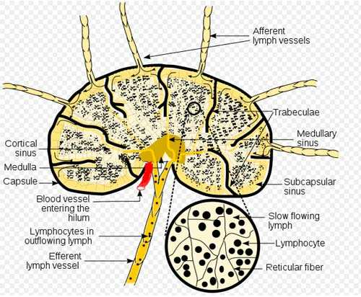
Lymph Node Venous Shunt
Connects Lymph Nodes to Veins
Used when nodes are present
Used in conjunction with other treatments

