Slide 1
Body Image & Sexuality After Breast Cancer
Lori Legrand, LCSW-R
Chris Karampahtsis, MD
Carole Filangieri, PhD
Department of Behavioral Health
516-663-2691

Slide 2
Outline
Historical perspective
Biological aspects
Psychological dynamics

Slide 3
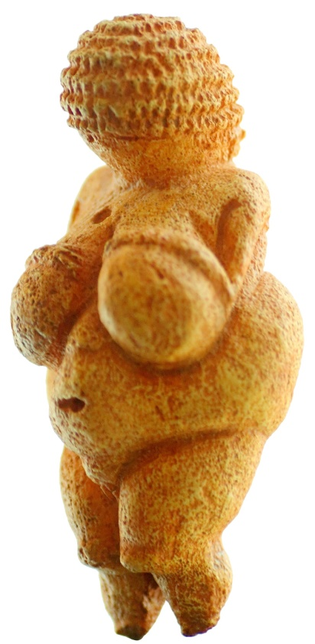
Society and the Importance of Breasts
27,000 BC
During the Upper Paleolithic and Neolithic Periods breast were depicted as expansive and pendulous (perhaps to depict fertility goddess)
The Venus
of Willendorf

Slide 4
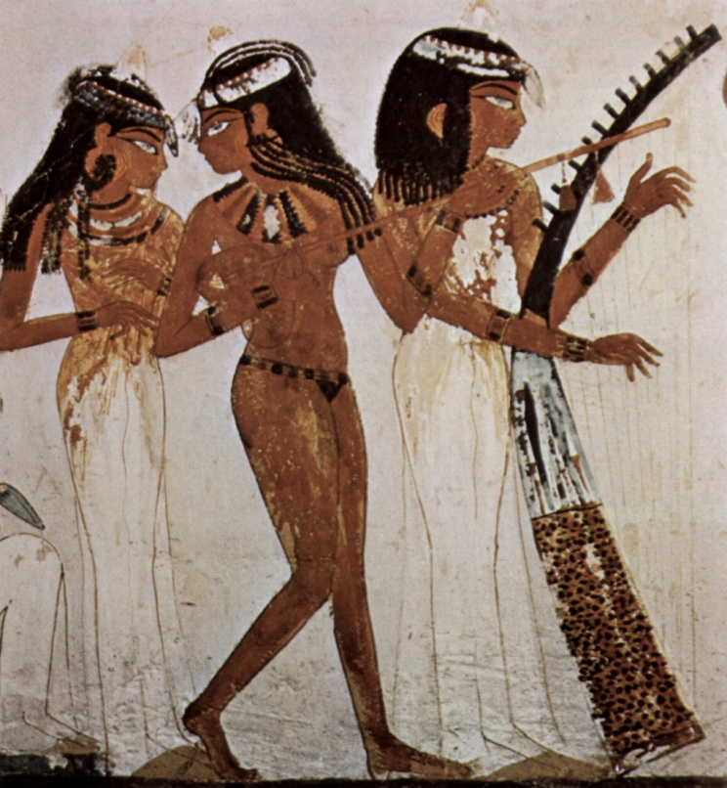
Society and the Importance of Breasts
Ancient Egyptians
While many of their art was erotic in nature, and breast were widely important for symbolic religious purposes, tended to depict women with no breasts at all.

Slide 5
Society and the Importance of Breasts
Hellenistic Greece
The ideal of breast proportion — one on either side of the chest with minimal sag, each measuring almost exactly a handful.

Slide 6
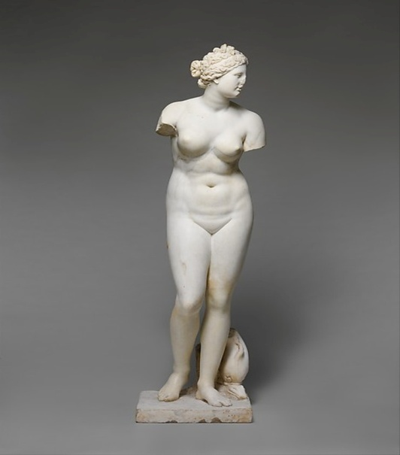
Society and the Importance of Breasts
Ancient Romans, like our modern society, had a few contradictory ideas about breasts. Big breasts were seen as sexually attractive — but breasts that were considered “too big” were mocked. Above all, the ideal Roman breast was perky, and did not need any support.

Slide 7
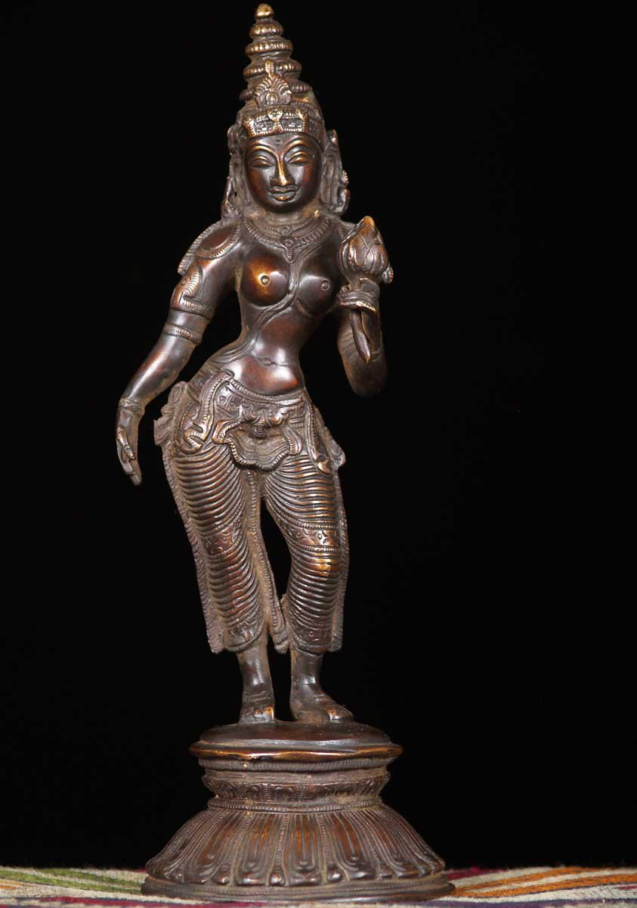
Society and the Importance of Breasts
Chola Dynasty
(9-13th century India)
Breasts were depicted as pneumatic, almost sphere like, with nipples pointing straight forward.
Parvati – Fertility Goddess

Slide 8
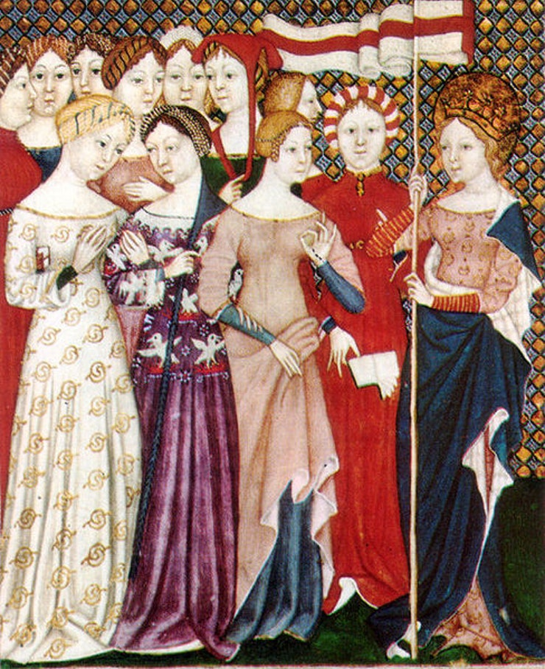
Society and the Importance of Breasts
Middle Ages
(11th-13th centuries)
Breasts were nearly invisible. The ascetic nuns, who often fasted for ages to prove their piety, were considered the ideal of beauty in this era. This pious Christian ideal of beauty also meant that large breasts were widely seen as sinful and something to be “fixed”.

Slide 9
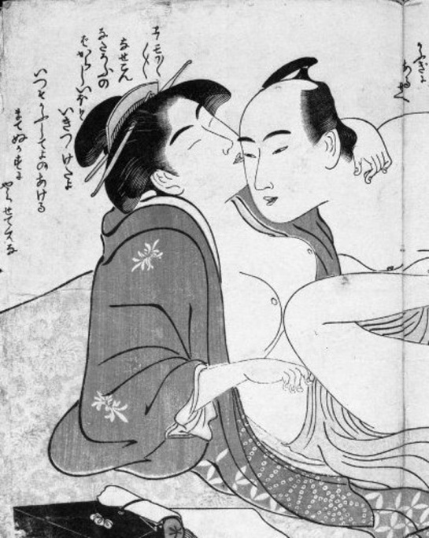
Society and the Importance of Breasts
Edo Japan (1630-1868)
Japanese erotic art called shunga flowered. Breasts that were large enough to sag slightly, with a pure white skin tone, and virtually non-existent nipples that could be signified by a tiny circle of the brush.

Slide 10
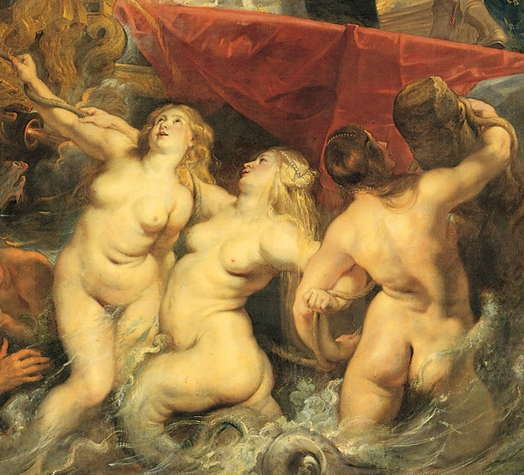
Society and the Importance of Breasts
1600s Europe
The time of “fleshy ladies”, though breasts were still meant to stay small and humble.

Slide 11
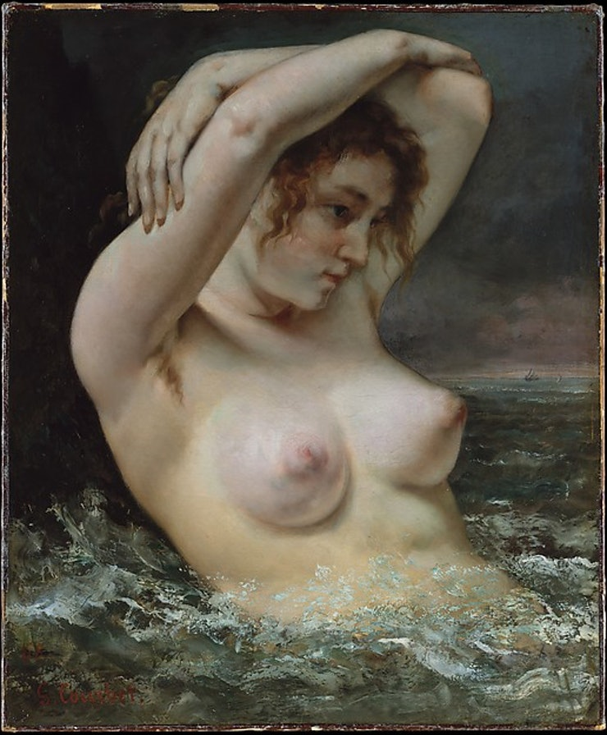
Society and the Importance of Breasts
19th Century France
Perhaps the first depiction of “realistic” breasts. Small, but with a slightly sagging shape that came to a point with pronounced nipples.

Slide 12
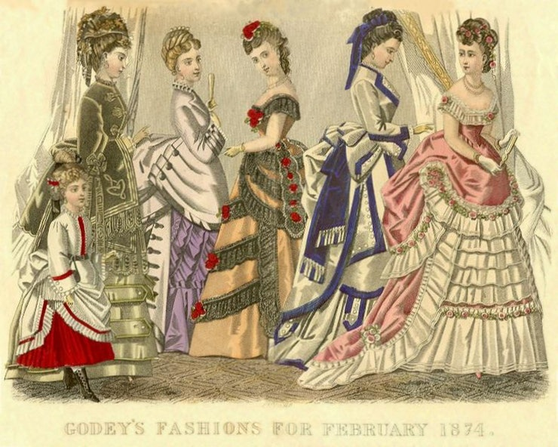
Society and the Importance of Breasts
Victorian England
Women were supposed to have a slight swell in their chests to indicate the possible presence of breasts, but anything more were considered vulgar.

Slide 13
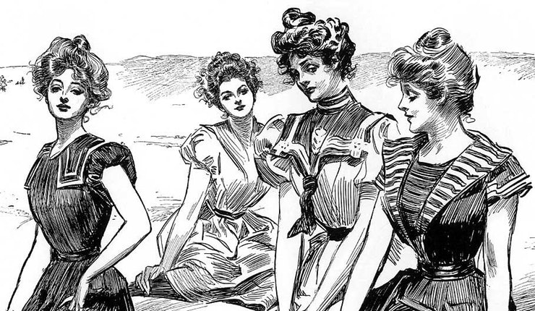
Society and the Importance of Breasts
Early 20th Century America
Illustrator Charles Gibson’s “Gibson Girls” set the beauty ideals for the time, and women of the period were supposed to wear pinched corsets, with their breast hanging over the top.

Slide 14
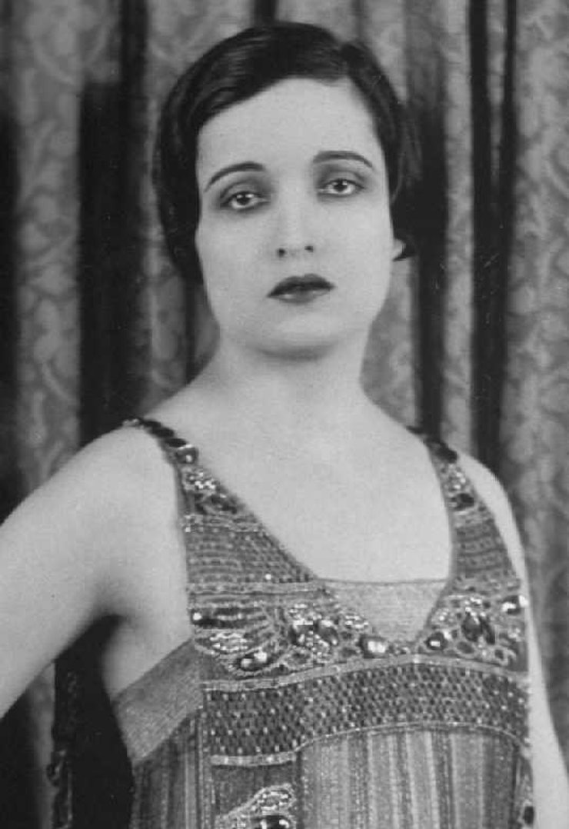
Society and the Importance of Breasts
The 1920’s and 30’s Flapper style dresses left no room for breasts, “wash-board flat chests” were most desirable.

Slide 15
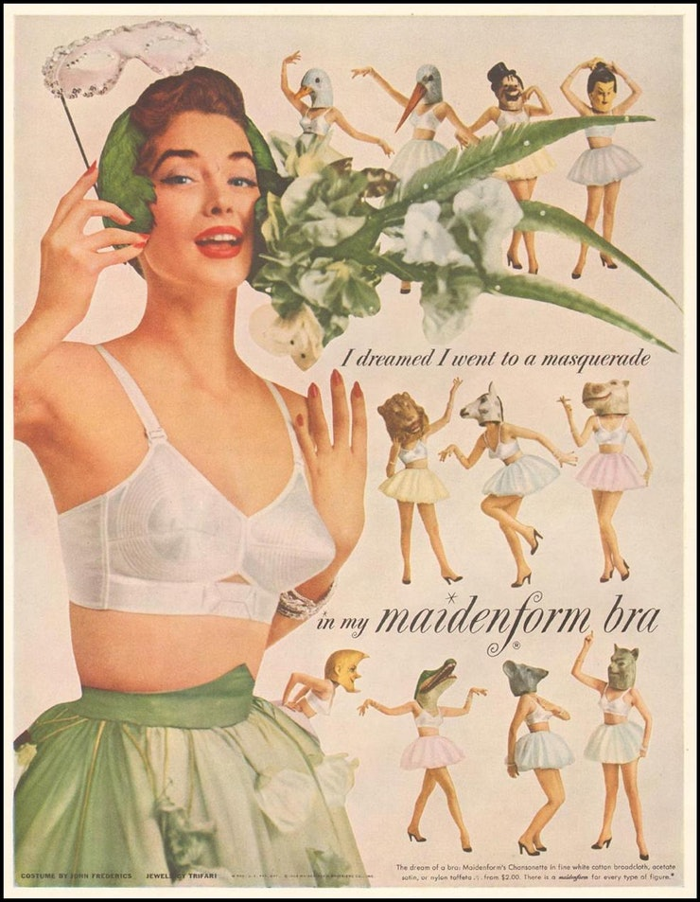
Society and the Importance of Breasts
The 1950s
The age of the Maidenform bra, and the girdle. Breasts supposed to be perky, held in place with lingerie meant to rig, and separate them, and make them look as pointed as possible.

Slide 16
Society and the Importance of Breasts
The 1960s
The female beauty icons of the ’60s were lithe rather than traditionally sexual, and their breasts were saggy (as bras were skipped) and small (to fit into shift dresses). The biggest model of the era, Twiggy, had an angular body and small breasts.

Slide 17
Society and the Importance of Breasts
The 1980s
What we think of as the “ideal” modern breast really came into fashion in the 1980s. Huge breasts on tiny frames were the mainstay of ’80s media, from films to TV, and became universally accepted as attractive.

Slide 18
Society and the Importance of Breasts
The 1990s
The breasts of ’90s beauty icons came in two very different sizes: the larger breasts of supermodels like Naomi Campbell, Christy Turlington, and Cindy Crawford, and the smaller breasts of Kate Moss, who based her career on her absence of cleavage.

Slide 19
Society and the Importance of Breasts
The 2000’s
These days, bigger breasts are still considered the societal norm. Kim Kardashian’s breasts gets more column inches than global warming. But if history is any indication, the pendulum may well swing back the other way entirely.

Slide 20
Biology

Slide 21
Sexuality
In general describes the entire manner or approach one expresses themselves as a sexual being.
Rich and complex area of human experience.
https://www.optionsforsexualhealth.org/sexual-health/sexuality
Notes:
Sexual expression varies in level of importance, how one chooses to express, and preferences

Slide 22
Components of Sexuality
Sensuality
Intimacy and relationships
Gender/sexual identity
Sexual health
Influenced by values, culture, experience, and spirituality.
https://www.optionsforsexualhealth.org/sexual-health/sexuality

Slide 23
Multifactorial dynamics of human sexuality

Slide 24
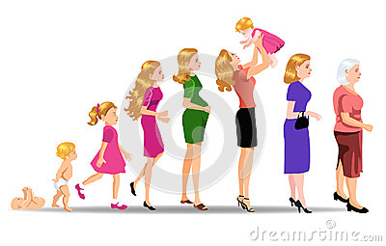
Average Age of Female Development
Pubic Hair (Pubarche) Age 8
Breast Development (Thelarche) Age 9
Menstruation (Menarche) Age 12
Puberty is complete Age 18
Fertility peaks Early-Mid 20’s
Menopause Begins Age 50

Slide 26
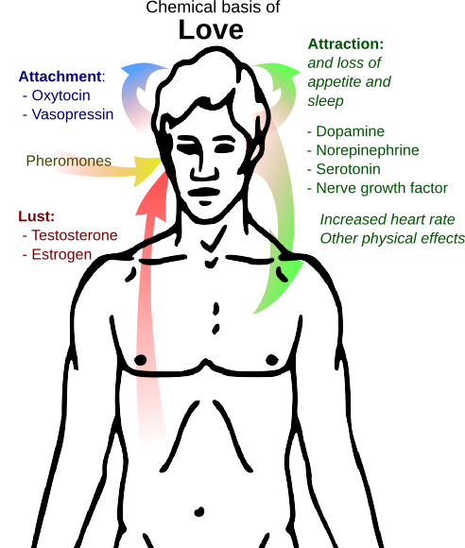
The Biology of Sexuality: Endogenous Chemicals

Slide 27
Dopamine
focused attention
causes each partner to focus intensely on one another
dopamine release is associated with producing a healthy attraction and dependency between the partners.

Slide 28
Norepinephrine
generates exhilaration and increased energy by giving the body a shot of natural adrenaline.
linked to raising memory capacity.
Whatever stimulus is being experienced in the presence of this chemical is “seared” in the brain.
This helps explain how a couple in love can remember the smallest details of their partner’s features.

Slide 29
Norepinephrine
Whatever stimulus is being experienced in the presence of this chemical is “seared” in the brain.
This helps explain how a couple in love can remember the smallest details of their partner’s features.

Slide 30
Serotonin
This natural chemical is released right after climax, bringing on a deep feeling of calmness, satisfaction and release from stress.

Slide 31
Testosterone
Testosterone is known as the hormone of sexual desire in both men and women.
For men, however, it is the key hormone of desire, triggering feelings of positive energy and well-being.

Slide 32
Oxytocin
The flood of oxytocin at climax acts as a natural tranquilizer, lowering blood pressure, blunting sensitivity to pain and stress, and inducing sleep.

Slide 33
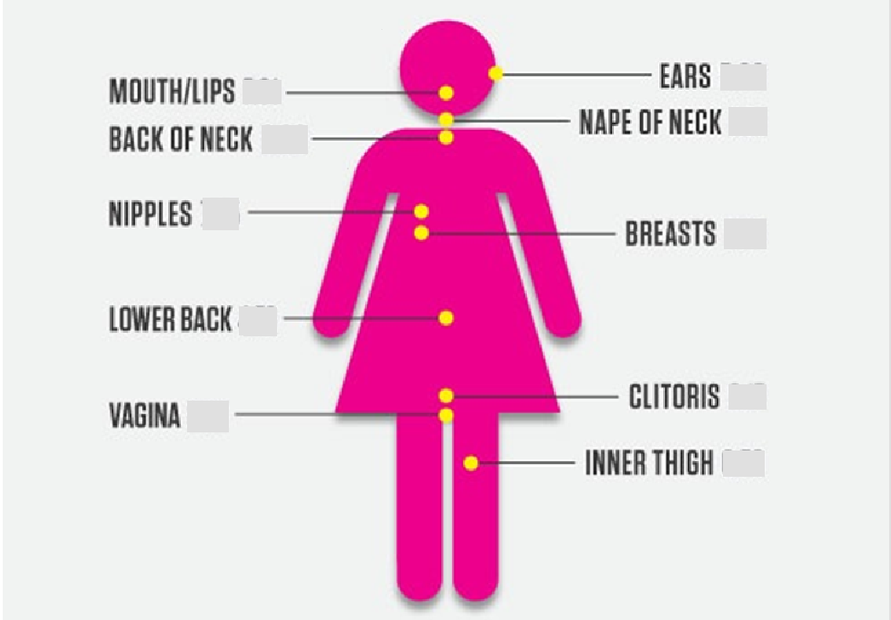
Erogenous Zones

Slide 34
Psychology

Slide 35
Gender Identity Development
Children use behavioral and physical cues to differentiate gender roles and to gender-type themselves
Three phases:
Ages 2-3: Gender identity acquired through reinforcement and role models
Ages 4-5: Gender stability - males stay male, females stay female
Ages 6-7: Gender constancy - changes in appearance or activity do not change gender

Slide 36
Body Image after Mastectomy
According to a 2016 Study:
Breasts are identified as femininity, beauty, motherhood and attraction. Not only an organ but a symbol to which may meanings are attached.
Mastectomy evoked both negative emotions due to the loss of the breast(s), and a sense of hope related to still being alive.
Many women wait after a mastectomy to look at the site, avoiding the scar, fear of what they might see.
After surgery many women described the site as “wretched, horrible, scary, ugly, crooked, and collapsed shape.”
Social identity affected after a mastectomy. Women felt “diminished as a women”, “half”, “abnormal” and “depressed.”

Slide 37
Communication is Key
With health care professionals:
Studies show that women are less likely to bring up the concern about breast cancer and sexuality with their health care professions due to:
Lack of time and privacy during office visits
Perceived perception of the health care provider’s interest and/or knowledge in the topic.

Slide 38
Communication is Key
With partners:
Sexual adjustment is based on several factors
Impact on body image, unique dynamics of the relationship, emotional make up of the individuals, psychological adjustment to the illness
Lower desire for intercourse may lead to higher levels of emotional intimacy
Involve your partner in decision-making of treatment
Partners play a critical role in helping to adjust to changes in body image and sexuality through support and reassurance.

Slide 39
Coping: Exercise
Exercise can help:
Improve sexuality
Improve body image
Reduce anxiety
Reduce depression

Slide 40
Coping: Early Menopause
Chemotherapy and other breast cancer treatments can lead to early menopause.
Menopause can cause changes in the body that lessen sexual pleasure, including vaginal dryness, decrease in sexual interest or desire.
Breast cancer survivors have several options for the relief of these symptoms, with or without hormones.
Talk with your health care provider about which options are best for you.

Slide 41
Coping: Cognitive Behavioral Therapy
Cognitive behavioral therapy (CBT) combines techniques such as cognitive reframing and relaxation exercises.
Some research suggests CBT improves sexual functioning for breast cancer survivors.
It can also help reduce fatigue and stress.

Slide 42
NYU Winthrop Hospital Breast Health Center
Dedicated Breast Nurse Navigator - Maya Kazanjian, BSN, RN
(516) 663-3887
Education on breast cancer, surgical procedures, treatment, surveillance and survivorship
In hospital post-op checks
Infusion Center visits
Communication with providers
Assistance with scheduling
Dedicated Breast Health Center Social Worker – Michelle DeCastro, LCSW, OSW-C
(516) 663-2556
Patient advocacy
Psychosocial Support (Individual, Group, Family, Caregiver)
Resources (DME, Legal, Financial)
Community and WUH Referrals
Insurance Trouble Shooting
Assistance with Disability
Transportation

Slide 43
Questions?

Slide 44
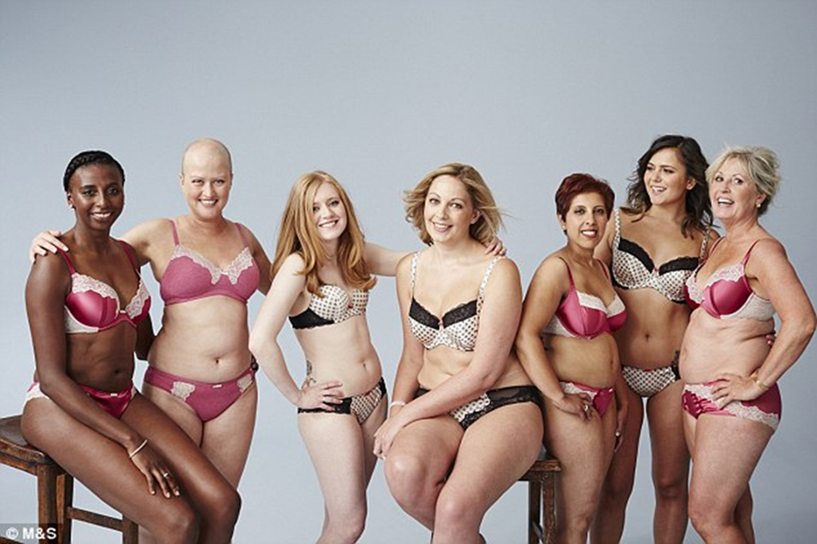
Sexuality after breast cancer

Slide 45
Agenda
Sexuality
What is it?
Sex & Breast Cancer
A screenshot
Sexual health
Sexuality after Breast Cancer
Challenges & Obstacles
Mind-body connection
Sexual function
What you can do:
Solutions
Reaching orgasm
Partner connection
Feeling good about you

Slide 46
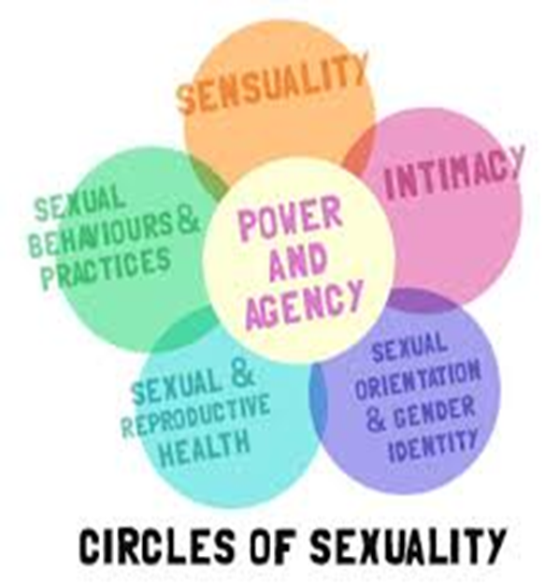
What is sexuality?
Sexuality refers to the total expression of who you are as a human being¹
Sexuality is the way you feel about yourself; it is linked to your need for caring, closeness, and touch
Sexuality can include sexual activity, but it doesn’t have to
Notes:
When you are first diagnosed with breast cancer, its hard to focus on anything other than survival
But after, you may wonder how normal your life can be or how cancer will affect your sex life
Sex and sexuality are important parts of everyday life. The difference between sex and sexuality is that sex is thought of as an activity – something you do with a partner and sexuality is more about the way you feel about yourself

Slide 47
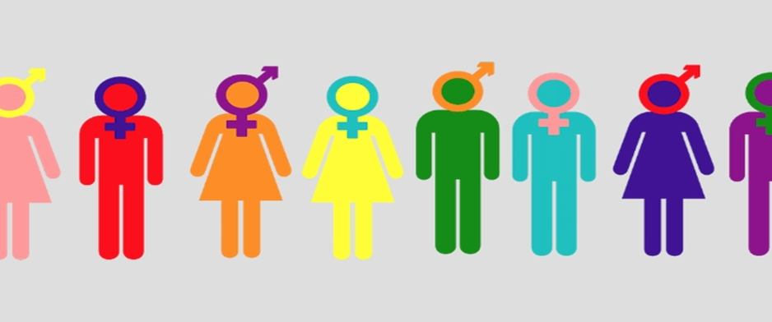
What is sexuality?
Gender, sexual orientation, and sexuality do not always coincide with each other⁷
Gender
A socially constructed system of classifications that ascribes qualities of masculinity and femininity to people
Sexual Orientation
The desire for intimate emotional and/or sexual relationships with people of the same gender, another gender, or multiple genders
Sexuality
Refers to a person’s exploration of sexual behaviors, practices, and identities in the social world
Notes:
Sexuality can differ for different groups, especially LGBTQ

Slide 48
LGBTQ+
As an LGBTQ+ person, you have unique concerns and experiences when it comes to your sense of self. It’s important to address these so that you can have the best possible quality of life before, during, and beyond treatment ⁸
Research suggests that similar to heterosexual women, the LGBTQ+ community who have a history of breast cancer have lower sexual desire, lower ability to reach orgasm, more sex-related pain and less sex than members of the LGBTQ+ community who have not had breast cancer ⁸

Slide 49
A sex snapshot:
There is enormous variability in the sexual repertoires of U.S. adults²
more than 40 combinations of sexual activity described at adults’ most recent sexual event
About 85% of men report that their partner had an orgasm at the most recent sexual event; this compares to the 64% of women who report having had an orgasm at their most recent sexual event²
STATISTICS:
7x per month between ages 30 and 40
6x per month between ages 40 and 50
5x per month between ages 50 and 60
For people over 60, the numbers continue to decline
However, it is important to remember that everyone’s sex life is different
Notes:
https://lgbt.williams.edu/resources/terms/

Slide 50
Sex & Breast Cancer
Many women report having less sex than before their illness for various reasons
The breast cancer experience slows down your body
Takes longer to get interested in and starting and finishing sexual intercourse
Sex may be uncomfortable or painful if you’ve been thrown into sudden-onset menopause
Changes in appearance and body image may affect desire to have sex Chemotherapy, endocrine therapy, surgeries and radiation can all have a large effect in altering a woman’s sexual health and function

Slide 51
Sex & Breast Cancer
Sexual concerns result in significant emotional distress
Sadness and/or depression
Issues related to personal appearance
Stigma
Negative impacts on personal relationships

Slide 52
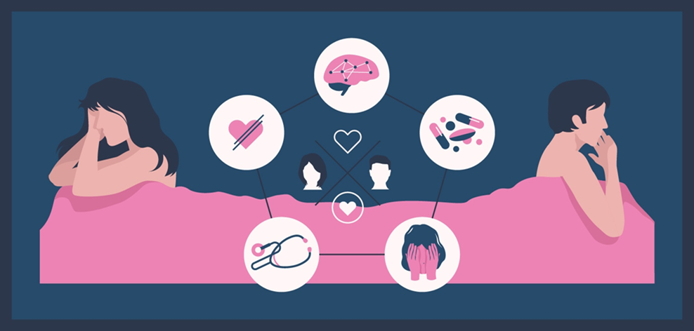
Sex & Breast Cancer
Boswell & Dizon, 2015
83 breast cancer survivors, all 3 or more years post diagnosis
Surveyed using the female sexual function index (FSFI) and the female sexual distress scale-revised (FSDS-R)
Found that 77% qualified for the diagnosis of sexual dysfunction on the FSFI alone
Notes:
You are not alone in what you are feeling

Slide 53
(Bozwell & Dizon 2015)
Notes:
*all of these things can change, the journey, before vs after

Slide 54
Sexuality after breast cancer: rediscovering the mind body connection
It is important to keep in mind that sexuality is not just a matter of sex itself and body parts
Rediscovering your identity can be a difficult concept for those who have completed their breast cancer journey³

Slide 55
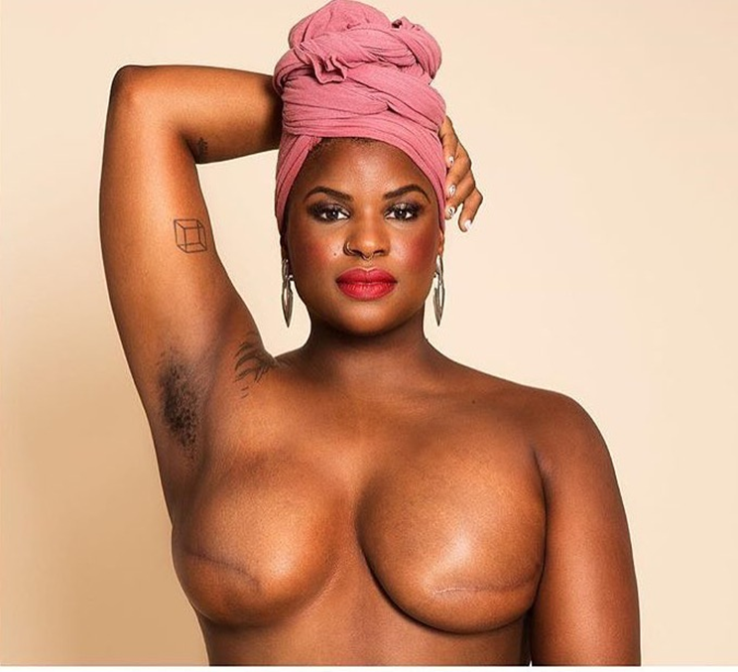
Sexuality after breast cancer: Body image
Your body has changed and therefore your body image has also changed
You may have lost your hair, breasts, weight, and are now in the process of adapting to your new body and the beginning of you post breast cancer journey
A part of that journey will be discovering yourself both physically and mentally, which are both major contributors to sexuality
Erika Hart, Women’s Health Activist
Notes:
Effort was on survival, emerging from treatment, how can you make yourself feel good
Take time to explore what your new normal is

Slide 56
Sexuality after breast cancer: Sexual function
Hormone therapies and chemotherapies can have an effect on the vagina and even change the vagina making intercourse painful or decreasing pleasure
There are treatments and solutions to vaginal dryness and other sexual functional concerns such as different moisturizers, lubricants, low-dose vaginal estrogen replacements, changing your physical position and learning how to relax the vaginal muscles can help⁵
In addition to the body changing due to breast cancer, a woman’s orgasms may change over time with or without cancer
As she gets older, orgasms may take longer to reach, and more mental excitement and touching may be needed

Slide 57
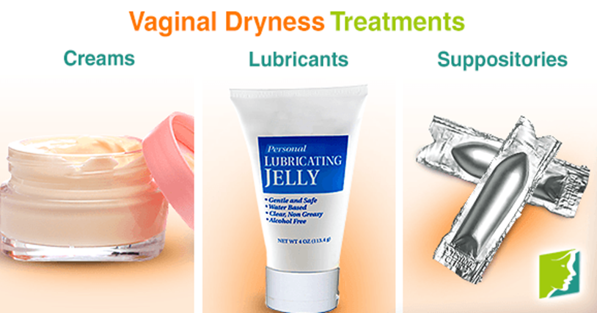
What Can you do?
Solutions to:
Vaginal Dryness
Reaching Orgasm
Sex Response

Slide 58
Vaginal Dryness: Solutions
Lubricants
Cancer treatments often reduce the amount of lubricant produced in your vagina when you are excited
Extra lubrication may be needed to make sex comfortable
Choose a water based gel that has no perfumes, coloring, spermicide, or added favors as these chemicals can irritate genital tissues
Examples: KY Jelly, Astroglide

Slide 59
Vaginal Dryness: Solutions
Vaginal Moisturizers
As women age, the vagina can naturally lose moisture and elasticity
Cancer treatments can speed up these changes
Vaginal moisturizers are non hormonal products intended to be used several times a week to improve overall vaginal health and comfort
Examples: Replens and KY Liquibeads, Lubrin, Astroglide Silken Secret, & Vitamin E gel caps

Slide 60
Vaginal Dryness: Solutions
Vaginal Estrogens
Topical or systemic estrogen therapy is a treatment option for vaginal atrophy
These hormones are applied to and absorbed into the genital area
They come in gel, cream, ring, and tablet forms
It is imperative to consult with your physician (oncologist, breast surgeon, etc.) before utilizing estrogens.

Slide 61
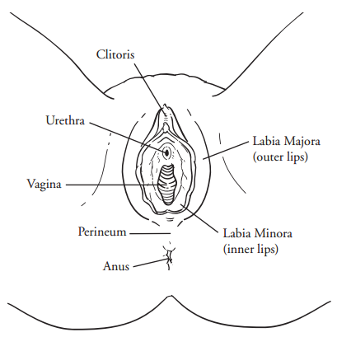
Reaching orgasm after cancer treatment
The clitoris has over 8,000 sensory nerve endings
That is often more nerve ending than a penis
So, the clitoris is our version of a man's penis... but even more sensitive

Slide 62
Reaching orgasm after cancer treatment
Traditional Sex Response Cycle
Orgasm
Plateau
Sexual Excitement/ Tension
Arousal
Reduction
Desire
Time

Slide 63
Intimacy based female sex response cycle
Emotional
Intimacy
Motivates the sexually
neutral woman
To find/
be responsive to
Emotional
and Physical
Satisfaction
Sexual
Stimuli
Arousal &
Sexual
Desire
Psychological and biological factors govern “arousability”
Sexual
Arousal

Slide 64
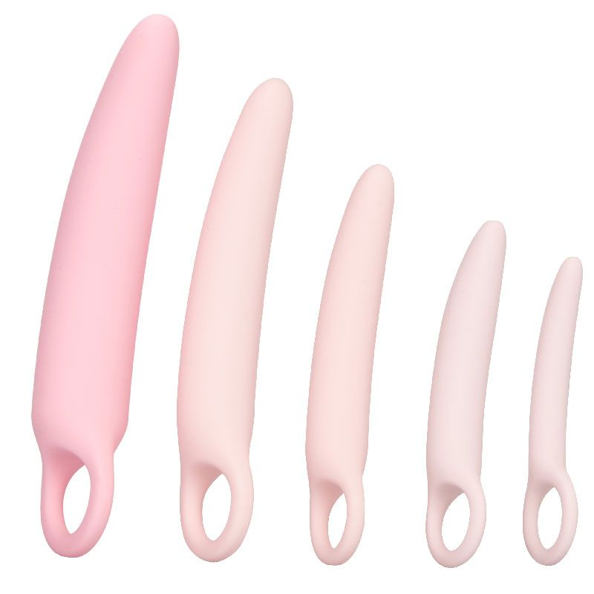
Reaching orgasm after cancer treatment
Use a hand-held vibrator
Can provide extra stimulation needed
Use kegel exercises to learn to relax the vaginal muscles
Identify your vaginal muscles and learn how to contract and relax them
Use a dilator for vaginal tightness
A plastic or rubber tube used to enlarge or stretch the vagina

Slide 65
Partner Communication
A trained social worker, sex therapist, psychologist, or psychiatrist can help you open up communication with your partner and get around to talking about intimacy and sex issue
Good communication is key to adjusting your sexual routine
Try to keep an open mind about ways to feel sexual pleasure

Slide 66
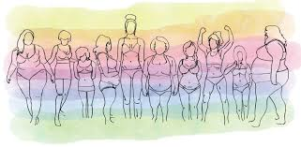
Feel good about yourself
Focus on your positive features
Look at yourself in the mirror and say 3 positive things about your looks
Look at yourself in the mirror naked – give yourself at least 3 compliments
Change your negative thoughts – write them down and counter each negative thought with a positive one
Notes:
Try to keep an open mind about ways to feel sexual pleasure. Some couples have a narrow view of what normal sex is. If both partners cannot reach orgasm through or during penetration, some may feel disappointed. But during and after cancer treatment, there may be times when the kind of sex you like best is not possible. Those times can be a chance to learn new ways to give and receive sexual pleasure.

Slide 67
Phenomenal woman, maya angelou
Now you understand
Just why my head’s not bowed.
I don’t shout or jump about
Or have to talk real loud.
When you see me passing,
It ought to make you proud.
I say,
It’s in the click of my heels,
The bend of my hair,
the palm of my hand,
The need for my care.
’Cause I’m a woman
Phenomenally.
Phenomenal woman,
That’s me.

Slide 69
References
Sexuality and Intimacy.” Susan G. Komen, 2017,
“A Definition of Sexuality.” A Definition of Sexuality, Sexuality Resource Center for Parents, 2017
“Female Sexual Health After Cancer.” Female Sexual Health After Cancer, LIVESTRONG, 3 Oct. 2016,
Boswell, Erica N., and Don S. Dizon. “Breast Cancer and Sexual Function.” Translational Andrology and Urology 4.2 (2015): 160–168. PMC.
“Cancer, Sex, and the Female Body.” American Cancer Society, American Cancer Society, Jan. 2017,
National Survey of Sexual Health and Behavior, Indiana University School of Public Health, 2010
LGBTQ Life at Williams, 2017
“I Am LGBT With Breast Cancer.” Living Beyond Breast Cancer, 20 July 2017, www.lbbc.org/i-am-lgbt-breast-cancer.

Slide 70
Thank You

